Slide 1
4-WHEELER NAVIGATION

Slide 2
Objective
Accurate Positioning: Real-time vehicle location for safe navigation.
Optimal Routing: Fastest, shortest, or traffic-aware routes with automatic re-routing.
Traffic Awareness: Real-time updates and congestion alerts.
Hands-Free Guidance: Voice navigation to reduce driver distraction.
Connectivity: Integration with smartphones (Android Auto / CarPlay) and vehicle systems.

Slide 3
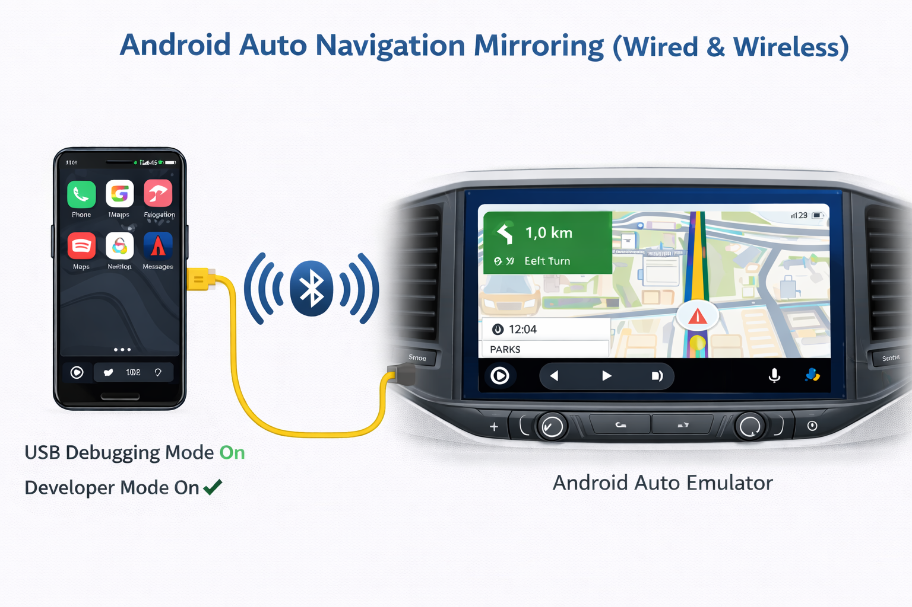
Notes:
Our system provides real-time monitoring and predictive maintenance for electric vehicle batteries and motors by tracking key parameters such as temperature, voltage, current, vibration, and speed.
It enhances safety by detecting early signs of overheating or faults, improves reliability through accurate State of Charge (SoC) and State of Health (SoH) estimation, and reduces maintenance costs by predicting failures before they occur.
By ensuring that batteries and motors operate within optimal conditions, the solution extends component lifespan and maximizes overall EV performance and durability.
Provides a smart predictive maintenance system that enhances safety, extends component lifespan, and reduces downtime in electric vehicles through real-time monitoring of battery and motor health.
Arduino IDE
// Initialization
void setup() {
initI2C(); // TMP117 sensor
initADC(); // Current, Voltage, Vibration sensors
init Speed Sensor(); // Interrupt or PCNT setup
init Communication(); // WiFi/Bluetooth/Serial for dashboard
initAlerts(); // LEDs, buzzer}
// Main loop
void loop() {
float temp = readTMP117();
float current = readCurrentADC();
float voltage = readVoltageADC();
float vibration = readVibrationADC();
float speedRPM = calculateSpeedRPM();
// Apply filtering
temp = filter(temp);
current = filter(current);
voltage = filter(voltage);
vibration = filter(vibration);
// Fault detection
if(temp > TEMP_THRESHOLD) alert("Over Temperature");
if(current > CURRENT_THRESHOLD) alert("Over Current");
if(vibration > VIBRATION_THRESHOLD) alert("Abnormal Vibration");
// Send data to dashboard
sendToDashboard(temp, current, voltage, vibration, speedRPM);
delay(100); // Adjust as needed
}
<number>

Slide 4
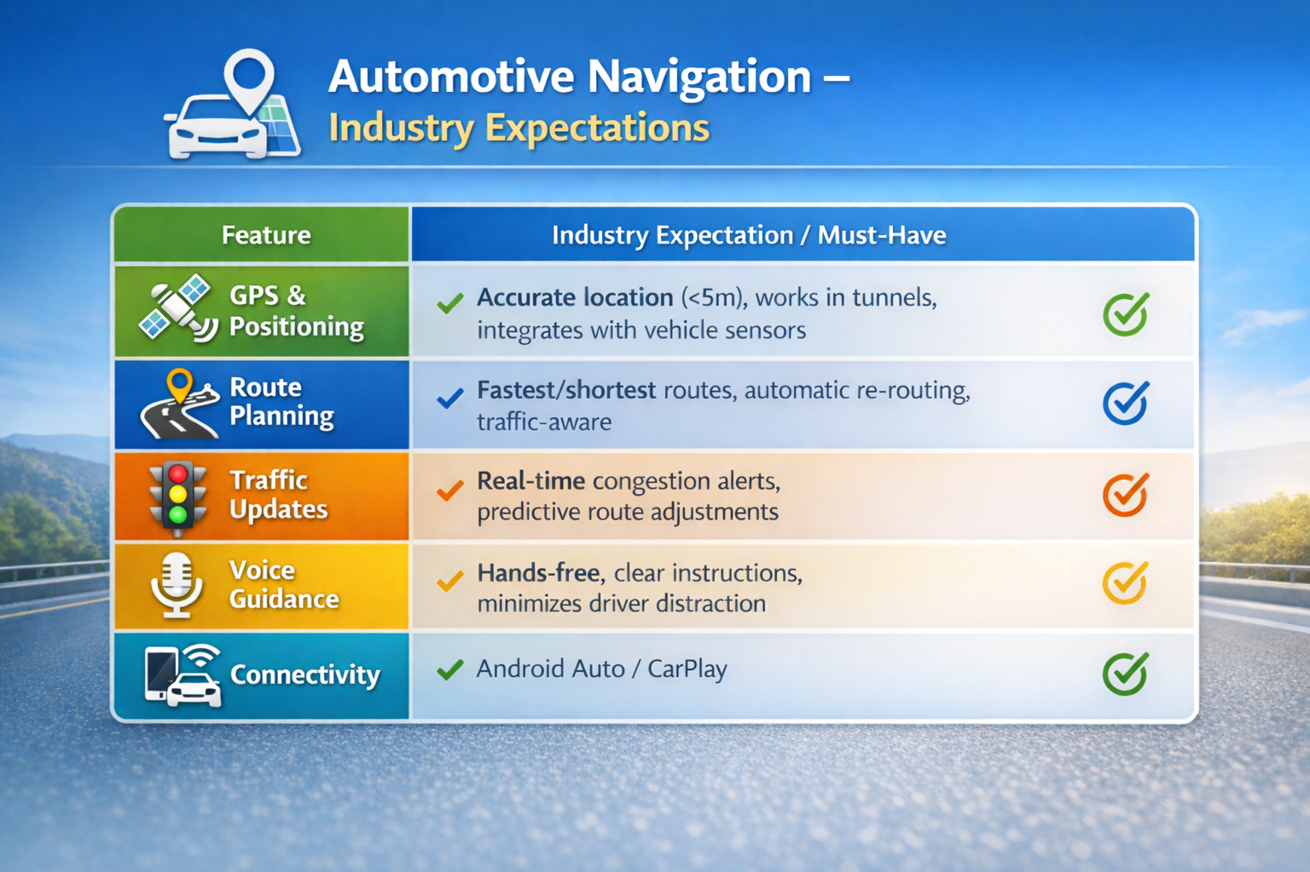

Slide 5
Android Auto Navigation Using Mapbox
Android Auto based navigation application was developed using Mapbox Navigation SDK.
Developer Mode and USB Debugging were enabled on the Android mobile device.
Mobile phone was connected to the system using a USB cable.
Android Auto Desktop Head Unit (DHU) emulator was used to simulate the monitor display.
Navigation app launched on the phone was mirrored on the emulator screen.
Map rendering, route calculation, and turn-by-turn guidance worked correctly in the emulator.
All major features such as voice prompts and UI interaction were validated successfully.
Limitations in OKT-507
Android auto not compatible with OKT-507.
No certification support for android auto .
So Android auto is not possible in OKT507 .
And also In OKT507 GPS is not there .

Slide 6
Feature | Industry Implementation | Our Implementation (Phone-based with DHU Emulator) | Implementation in OKT507-C Board
GPS Positioning | Head unit has its own GPS hardware | Phone GPS is used; DHU only shows the location | OKT507 has no GPS
Route Planning | Routes are calculated in the head unit | Phone calculates the route | OKT507 only shows the route on screen
Traffic Updates | Traffic data comes from vehicle network | Phone gets traffic data | OKT507 only displays traffic info
Voice Guidance | Head unit gives voice directions | Phone gives voice directions | OKT507 plays voice through speakers
Connectivity | Head unit uses built-in network | Phone connects to DHU using USB | OKT507 uses USB for Android Auto,But Certification Required

Slide 7
THANK YOU

